Slide 1

BASIC NETWORKING
NETWORKING
TODAY

Slide 2


OBJECTIVES FOR TODAY
Explain how networks affect to our daily lives
Identify the difference type of network size and devices
Explain how LANs and WANs interconnect to the Internet

Slide 3




ENGAGE
What life would be like without the
2 MIN
Internet ?
Notes:
Life without internet would be like:
No internet-communication (e-mail, messenger, social media ...)
Effect on Business (online store, e-commerce, making money online …)
Access to information & resource cut (education, entertainment…)

Slide 4
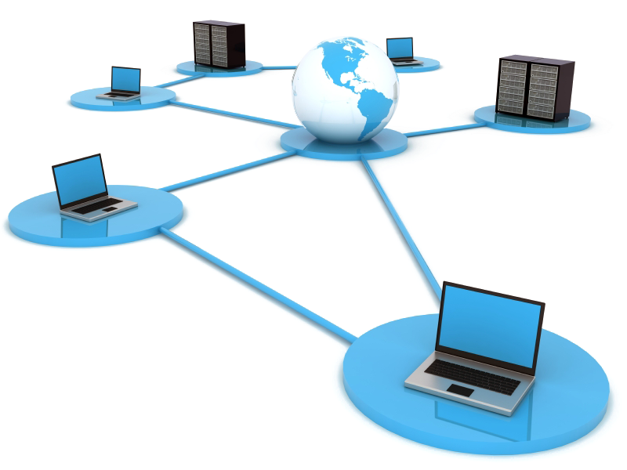
Introduction to NETWORK

Slide 5

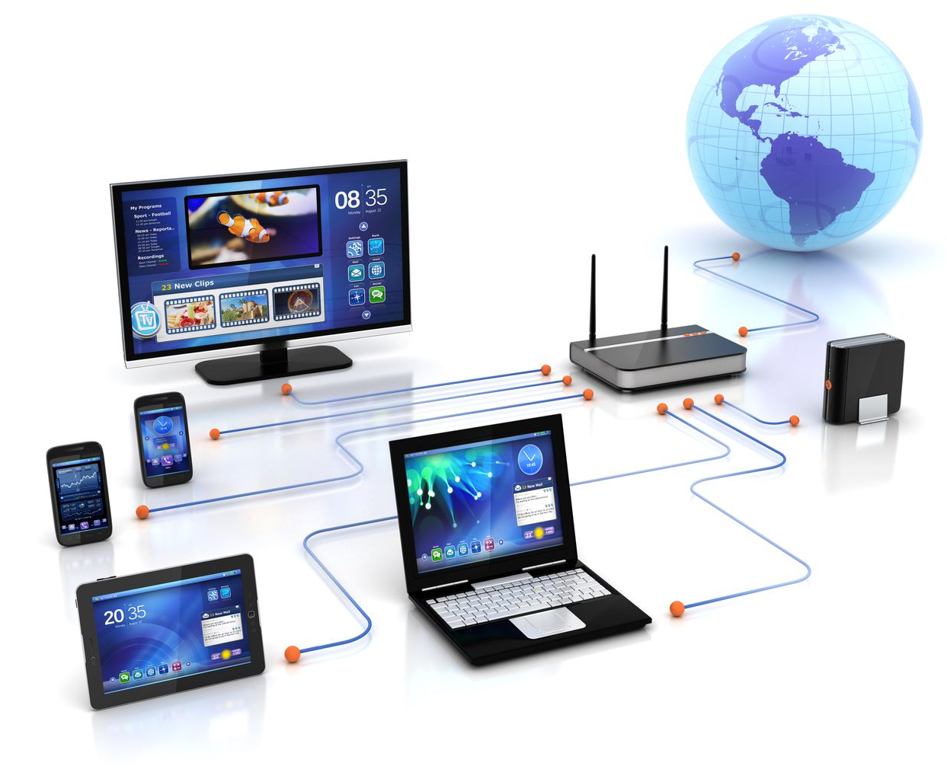
EXPLAIN
Computer Networking
5 MIN
A computer network is a connection between two or more computers to allow to exchange files or information between the computers

Slide 6

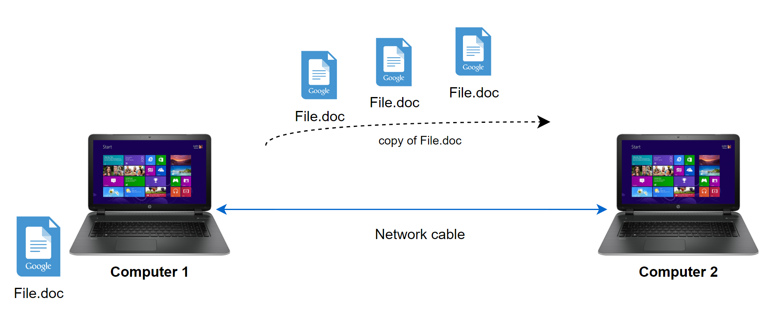
EXPLAIN
Example of what network can help us
5 MIN
Sharing Files

Slide 7

EXPLAIN
Example of what network can help us
5 MIN
Remote access

Slide 8

EXPLAIN
Example of what network can help us
5 MIN
User management centralize

Slide 9
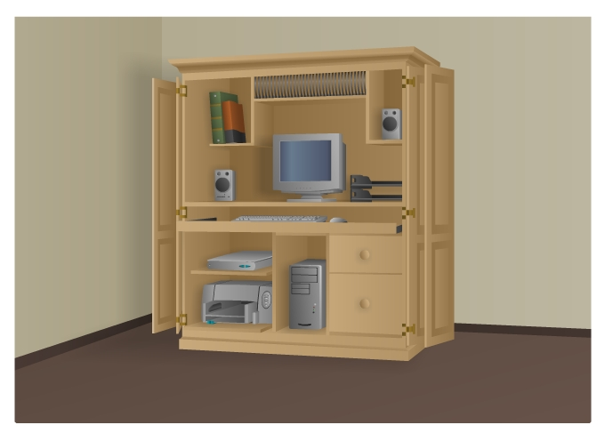
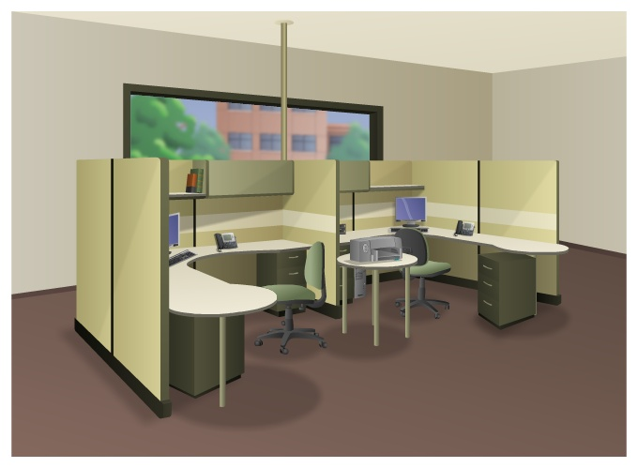
EXPLAIN
Network Size
5 MIN
Small Home
SOHO
Small Home Networks – connect a few computers to each other and the Internet
Small Office/Home Office (SOHO) – enables computer within a home or remote office to connect to a corporate network

Slide 10
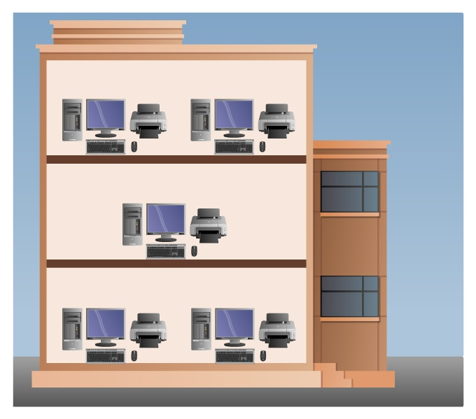
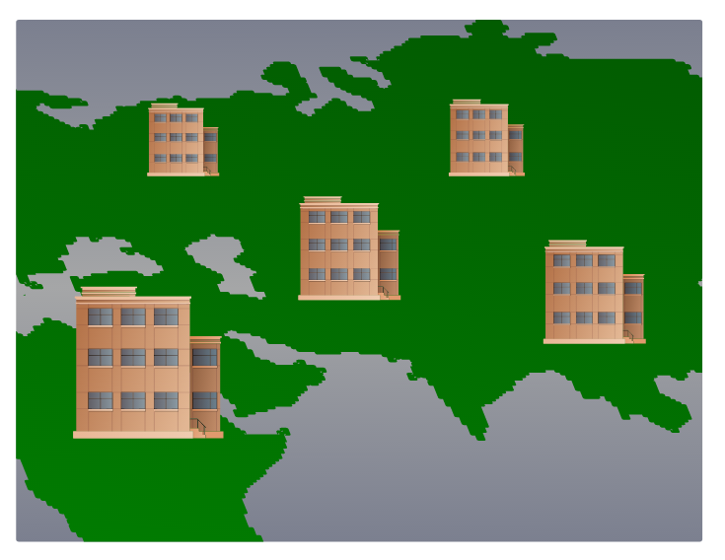
EXPLAIN
Network Size
5 MIN
Medium/Large
World Wide
Medium to Large Networks – many locations with hundreds or thousands of interconnected computers
World Wide Networks – connects hundreds of millions computers world-wide – such as the internet

Slide 11
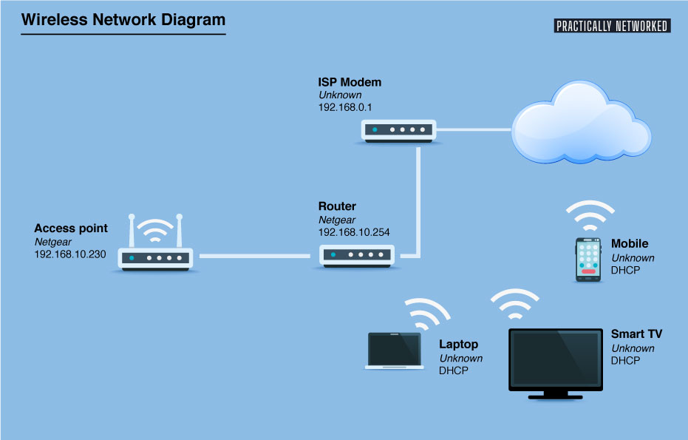
EXPLAIN
Example of Home Network Design
2 MIN

Slide 12



ACTIVITY
ACTIVITY 1
5 MIN
Classify the network type of the following scenarios
Click here for the activity!

Slide 13
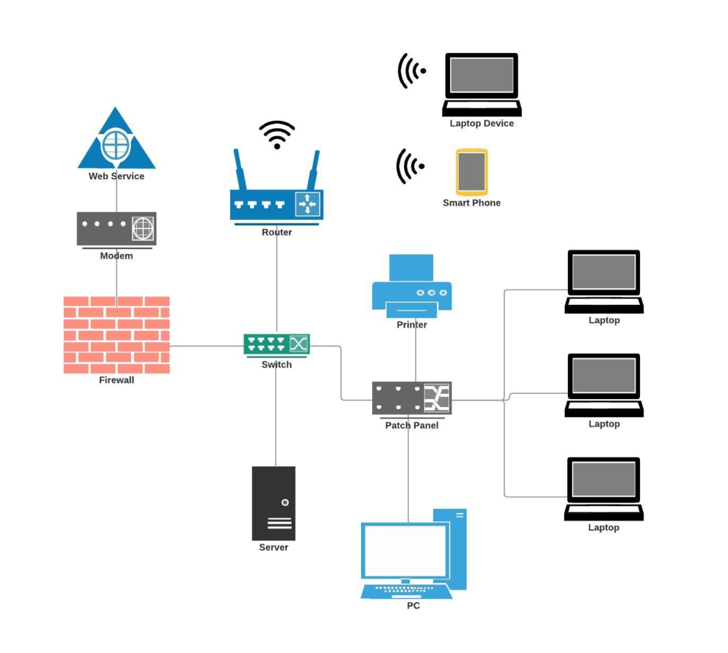
Network Component

Slide 14
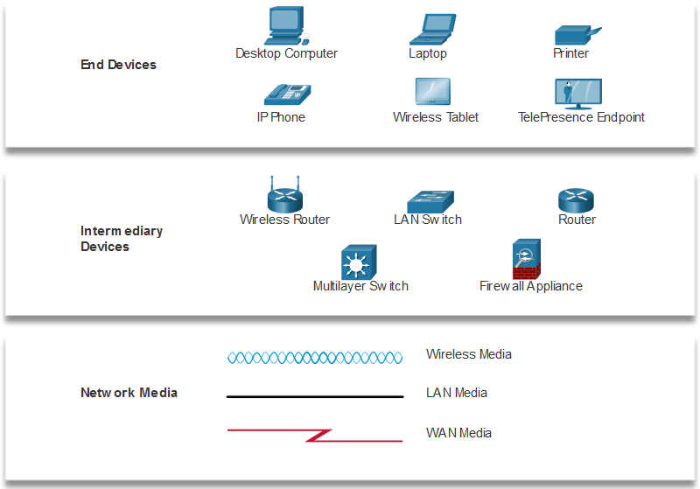
EXPLAIN
Network Component
5 MIN
Network Infrastructure
The network infrastructure contains three categories of hardware components:
End devices
Intermediate devices
Network media

Slide 15

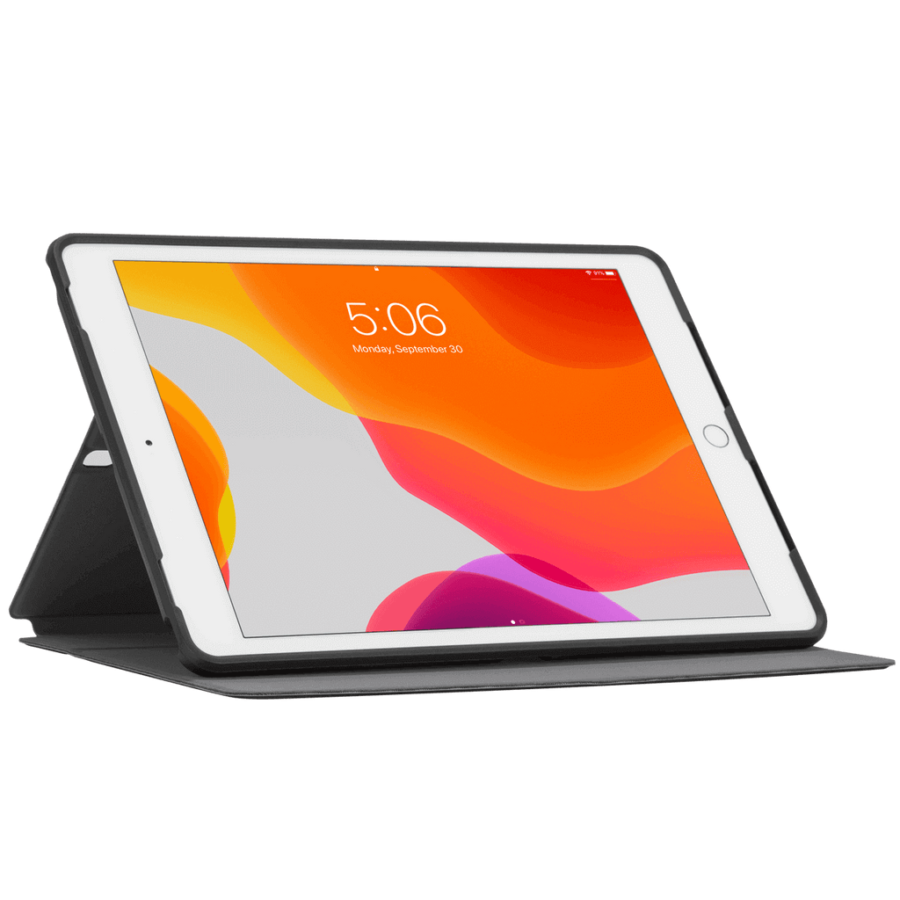

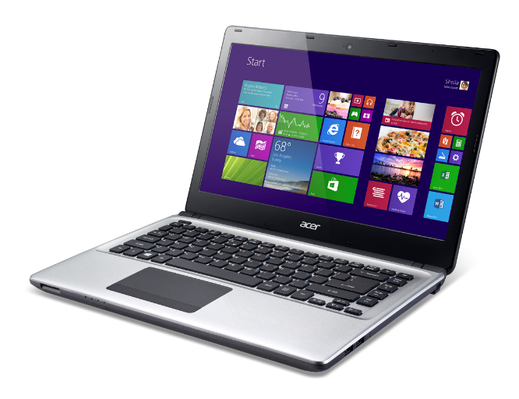
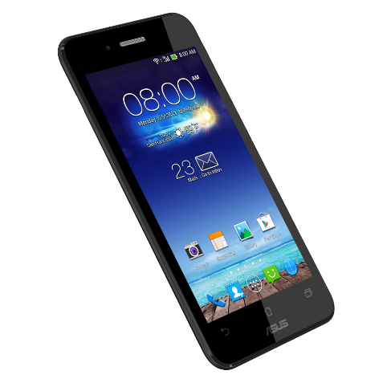
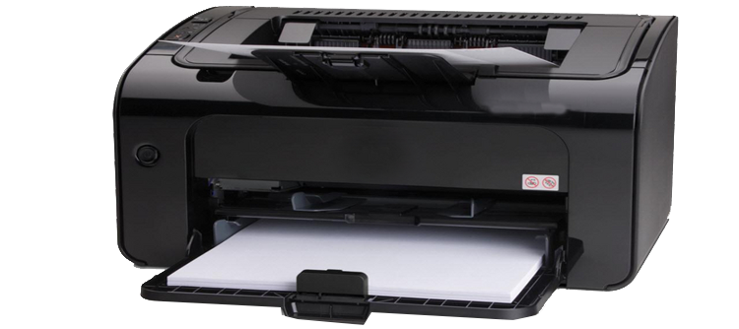
EXPLAIN
Network Component
5 MIN
End devices
An end device is where a message originates from or where it is received. Data originates with an end device, flows through the network, and arrives at an end device.
Desktop
Laptop
Printer
Smart phone
Tablet
Telepresence
Notes:
- Normally, end devices are directly working with users.

Slide 16
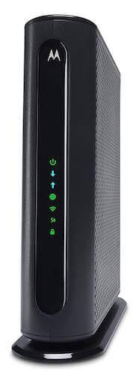
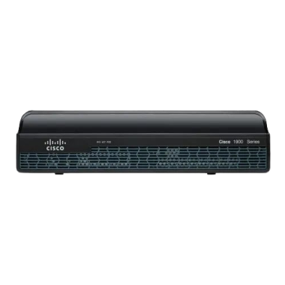
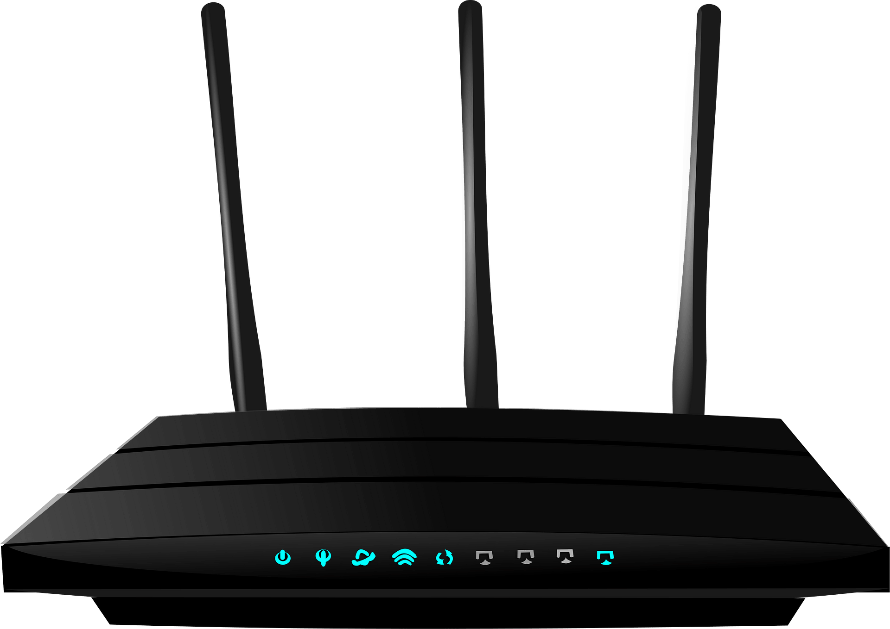
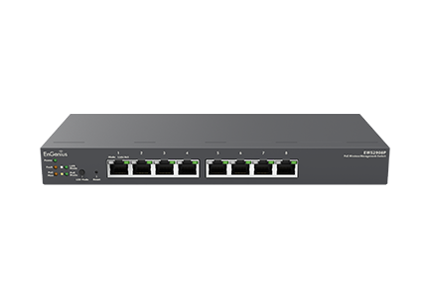
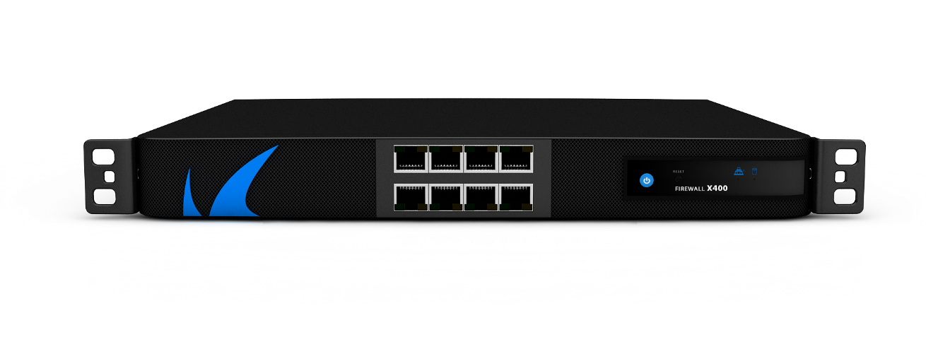
EXPLAIN
Network Component
5 MIN
Intermediate devices
An intermediary device interconnects end devices. Examples include switches, wireless access points, routers, and firewalls.
Wireless Access Point
Switch
Router
Firewall
Modem
Notes:
- Intermediate devices are used to configure, manage, sharing, and protect the connection on end devices.

Slide 17
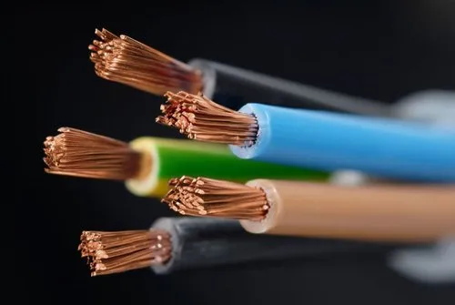
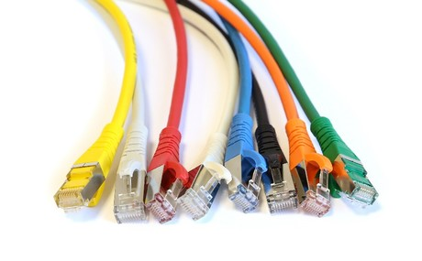
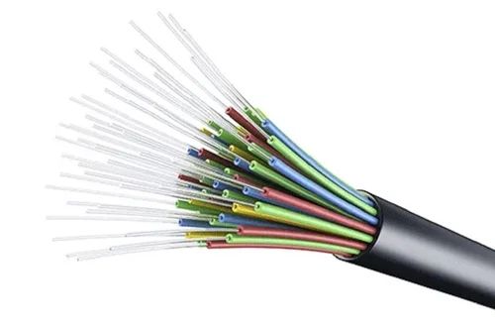
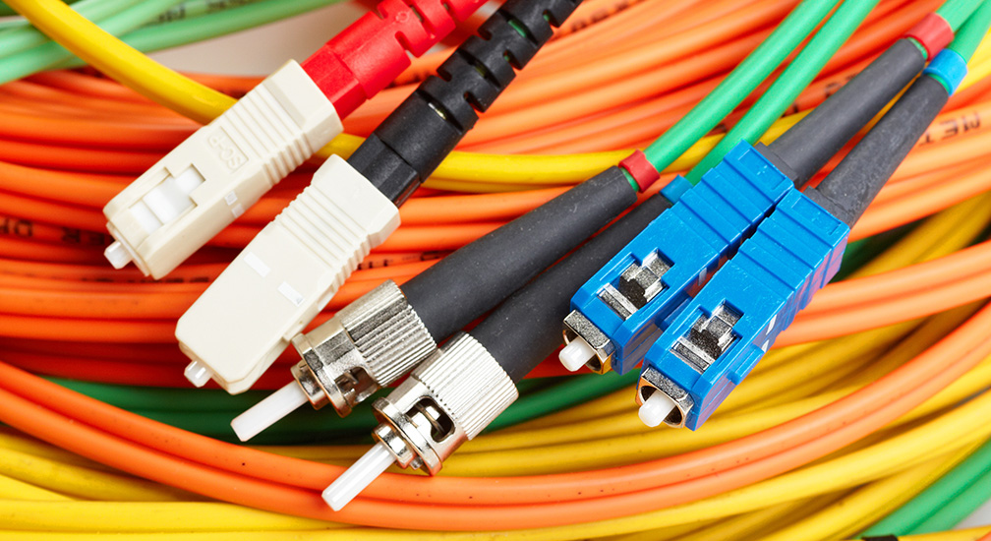
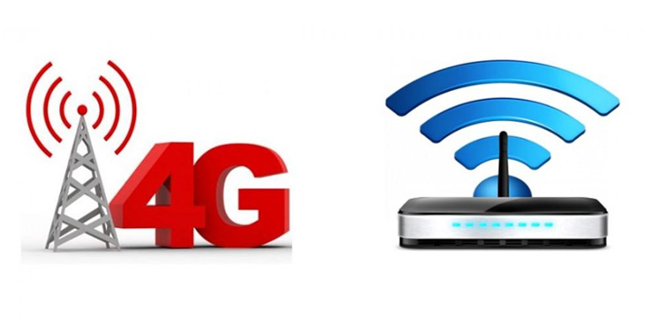
EXPLAIN
Network Component
5 MIN
Network Media
Communication across a network is carried through a medium which allow a message to travel from source to destination.
Media Types | Description
Metal wires within cables | Uses electrical impulses
Glass or plastic fibers within cables (fiber-optic cable) | Uses pulses of light.
Wireless transmission | Uses modulation of specific frequencies of electromagnetic waves.
Copper
Fiber-Optic
Wireless
Notes:
- Network media are used to connect between devices in a network.

Slide 18


ACTIVITY
ACTIVITY 2
10 MIN
Define the role of network component of following picture:
End device
Intermediate device
Network Media
?
Internet
?
?
?
?
?
?
?
?
?
?
?
?

Slide 19
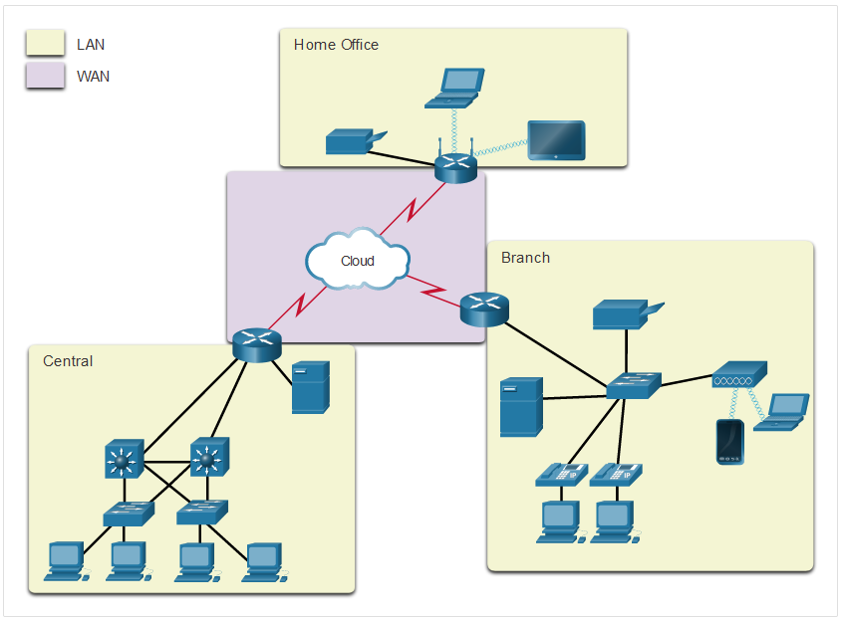
EXPLAIN
Common Types of Networks
5 MIN
Two most common types of network
Local Area Network (LAN)
Wide Area Network (WAN)

Slide 20
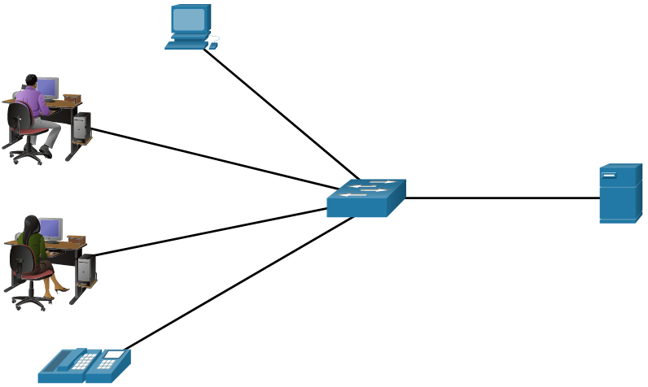
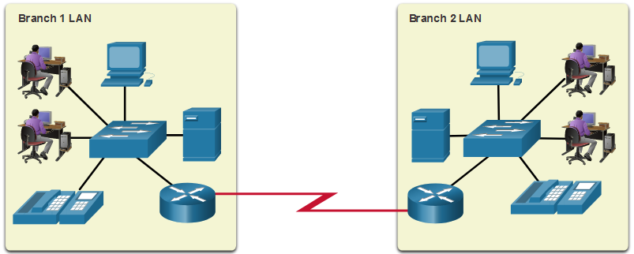
EXPLAIN
Common Types of Networks
5 MIN
A LAN is a network infrastructure that spans a small geographical area.
A WAN is a network infrastructure that spans a wide geographical area.

Slide 21

Introduction to INTERNET

Slide 22
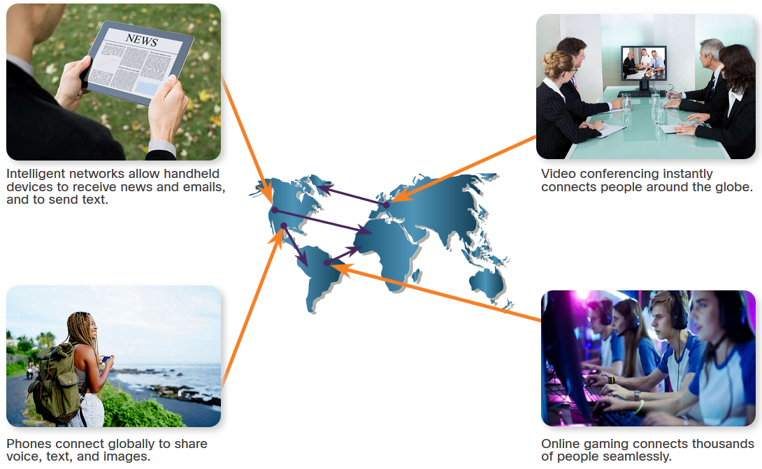
EXPLAIN
What is the “ INTERNET ” ?
5 MIN
The internet is a worldwide collection of interconnected networks (LANs & WANs), cooperating with each other to exchange information.
The internet helps to transfer the data or information from one to another computer through the network.
Notes:
- https://edu.gcfglobal.org/en/internetbasics/what-is-the-internet/1/#

Slide 23
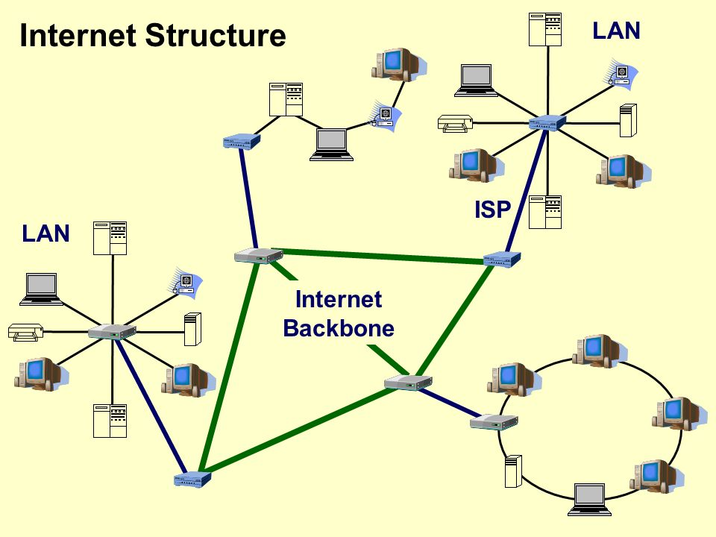
EXPLAIN
5 MIN
The internet is a global network of networks.
Internet is made up of many different networks, in different countries around the world that are all connected together into one huge WAN.

Slide 24



EXPLAIN
Who Owns “The Internet”?
5 MIN
The internet is not owned by any individual or group. The internet is nothing but a connection between networks all around the world.
The following groups were developed to help maintain structure on the internet:
IETF (Internet Engineering Task Force)
ICANN (Internet Corporation for Assigned Names and Numbers)
IAB (Internet Architecture Board)

Slide 25


WATCH & THINK
5 MIN
How does the Internet work?
3mins Video
Notes:
https://www.youtube.com/watch?v=2CJcotBkf6w
Question on video:
What are the keyword that new to you?
Do you know the internet is about physical connection?
What’s the difference between Internet and Wi-Fi?
What is world wide web?

Slide 26
WATCH & THINK
Questions
5 MIN
1. What is World Wide Web?
2. What are the keywords that new to you?
3. What’s the difference between Internet and Wi-Fi?
4. Do you know the internet is about physical connection?
Notes:
https://www.youtube.com/watch?v=2CJcotBkf6w
Question on video:
What are the keyword that new to you?
Do you know the internet is about physical connection?
What’s the difference between Internet and Wi-Fi?
What is world wide web?

Slide 27

Internet Affect Our Lives
In today’s world, through the use of Internet, we are connected like never before.

Slide 28

EXPLAIN
The Advantage Of The Internet
5 MIN
Communication Online
Information availability
Education
Entertainment
E-Commerce / Shopping
Business
Social Networking

Slide 29

EXPLAIN
The Dark Side Of The Internet
5 MIN
Internet Addiction / waste of time
Cyberbullying / Mental health issues
Identity Theft
Misinformation / Fake News
Privacy Concern
Online Cybercrime
Virus and Hacking Issues

Slide 30

EXPLORE
How can we connect to the Internet?
5 MIN
Can we buy the Internet?
Who can give us access to the Internet?

Slide 31
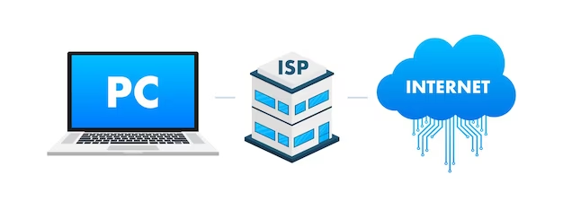
EXPLAIN
Internet Service Provider (ISP)
5 MIN
An ISP, or internet service provider, is a company that provide people access to the internet, usually with a monthly subscription.
For their services, the customers have to pay the ISP a nominal fee which varies according to the amount of data they actually use or data plan which they purchase.
Notes:
https://whatismyipaddress.com/isp
https://kinsta.com/knowledgebase/what-is-isp/

Slide 32
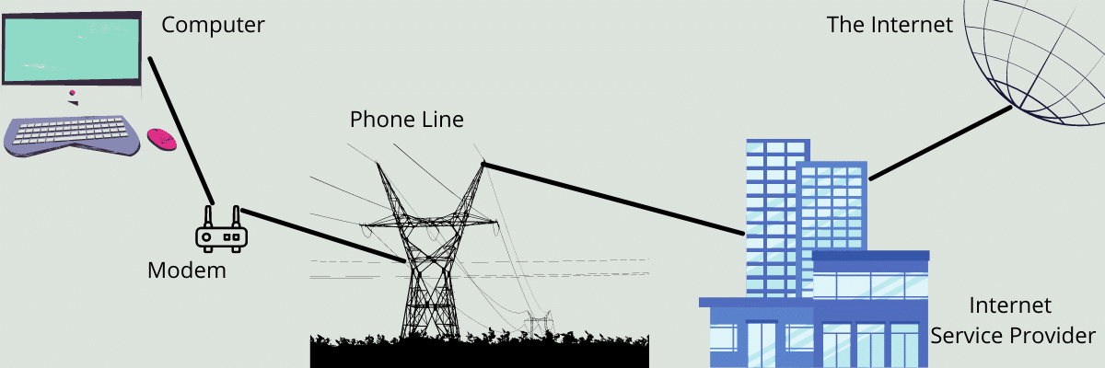
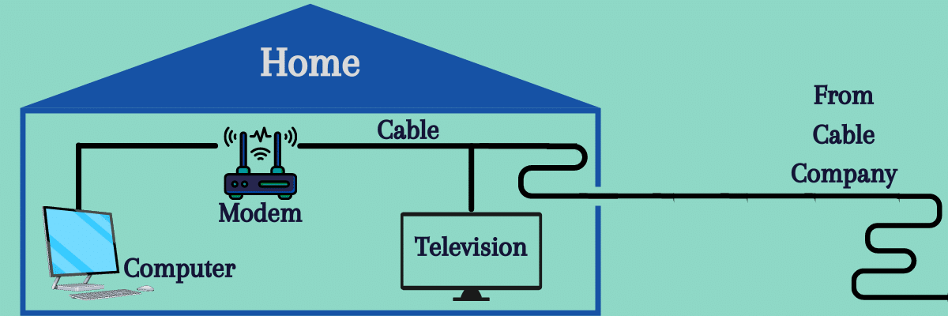
EXPLAIN
Type of Internet connections
5 MIN
Home and small office Internet connections
Dial-up Connection
Inexpensive, low bandwidth option using a modem.
Cable Broadband Connection
High bandwidth, internet offered by cable television service provider.
Notes:
https://whatismyipaddress.com/isp
https://www.geeksforgeeks.org/isp-full-form/
https://kinsta.com/knowledgebase/what-is-isp/
https://www.youtube.com/watch?v=93-3zmVvCGU

Slide 33
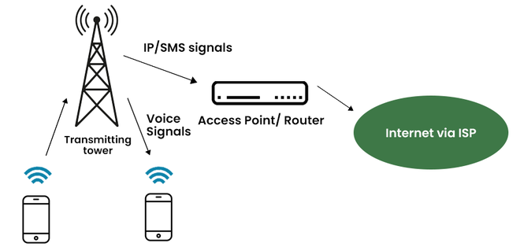
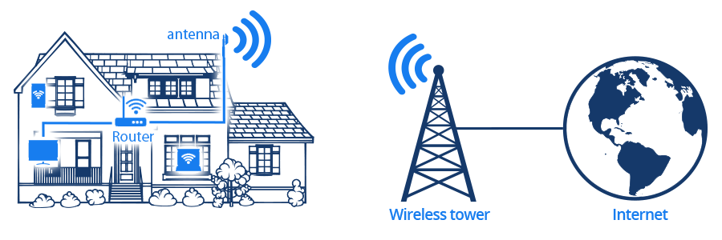
EXPLAIN
Type of Internet connections
5 MIN
Home and small office Internet connections
Mobile Internet (Cellular)
Provide wireless Internet access through cell phones. The common cellular network are 3G, 4G, 5G.
Wi-Fi Internet Connection
Uses a radio frequency band to connect to the internet. Speed may vary for different locations.

Slide 34
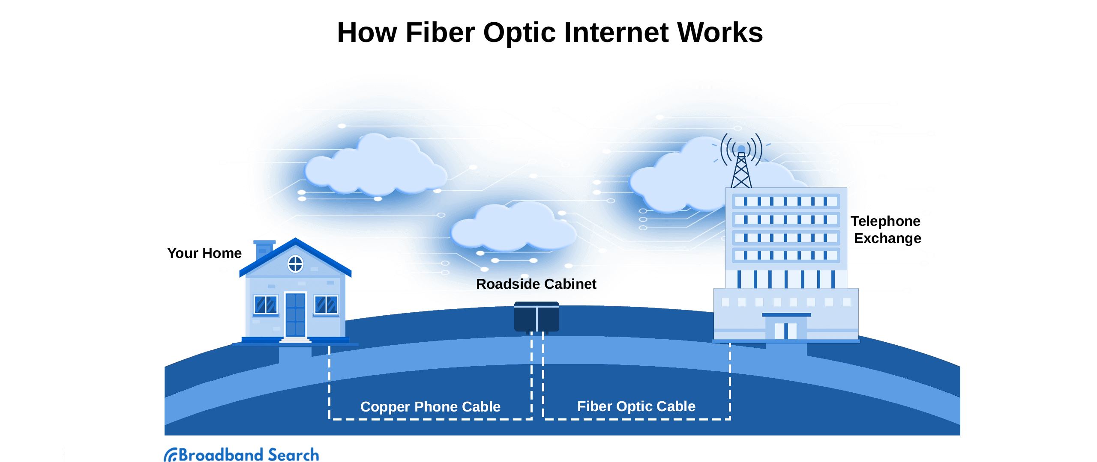
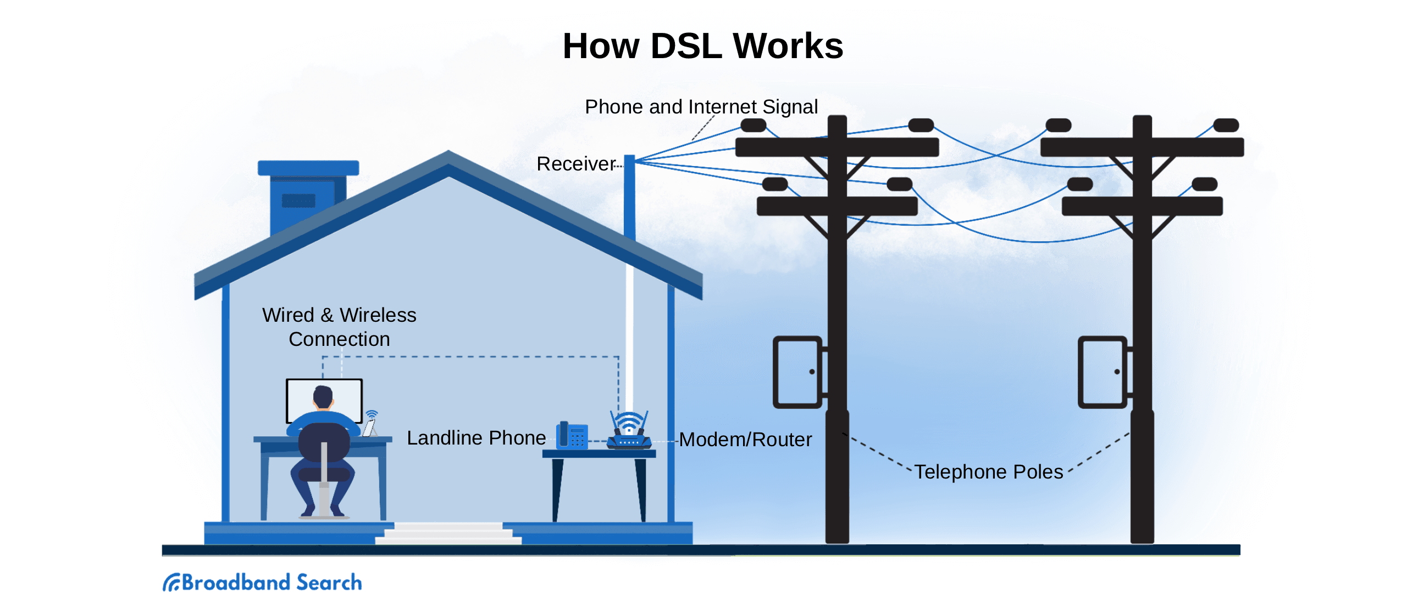
EXPLAIN
Type of Internet connections
5 MIN
Business Internet connections
Fiber Internet Provider
Fiber optic is the fastest internet service. The cable made from glass strands to transmit data at the speed of light.
DSL Connection
high bandwidth solution, internet connection that runs over a telephone line.
Notes:
https://www.broadbandsearch.net/blog/set-up-home-fiber-network
https://www.broadbandsearch.net/blog/choose-a-dsl-cable-cord

Slide 35
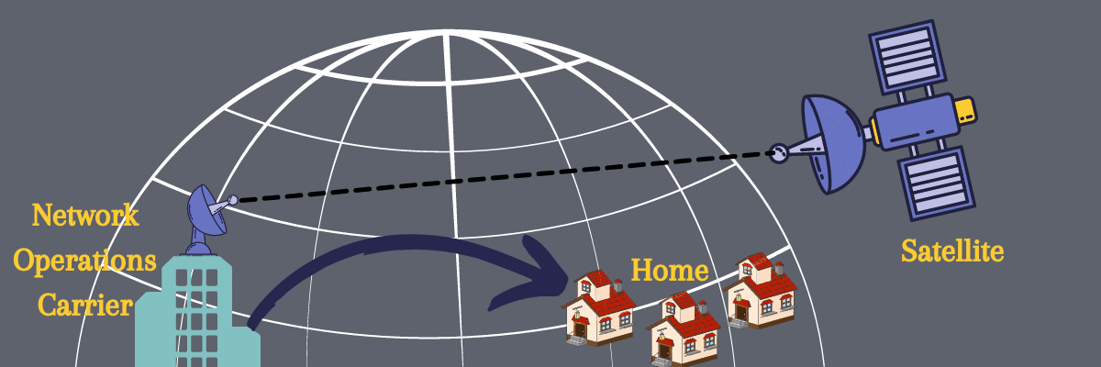
EXPLAIN
Type of Internet connections
Business Internet connections
Satellite Internet Connection
The signal travels from a long distance that is from earth to satellite and back again which provides a delayed connection.

Slide 36
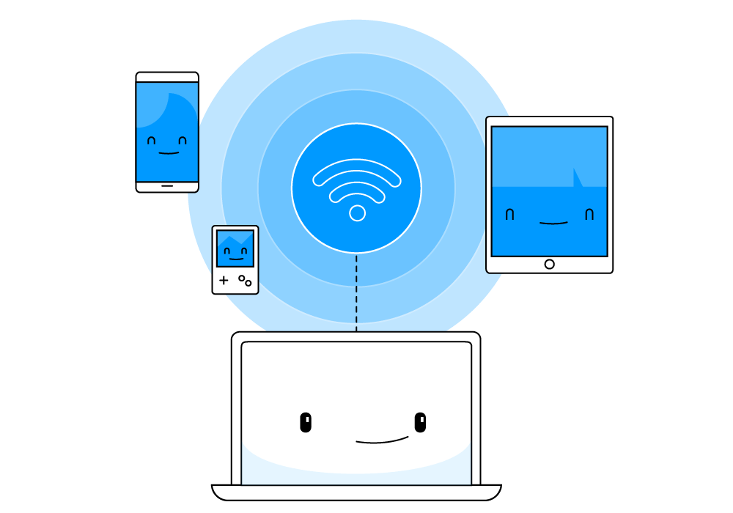
Wireless Network

Slide 37
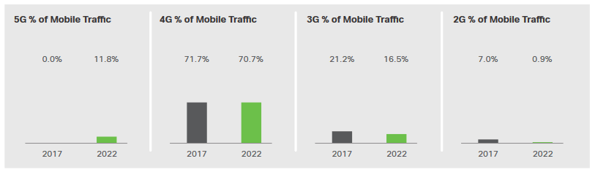
EXPLAIN
Wireless Networks
5 MIN
Cell Phone Network
The abbreviations 3G, 4G, 4G-LTE, and 5G are used to describe enhanced cell phone networks that are optimized for the fast transmission of data.
The “G” in these designations represents the word “generation,” so 5G is the fifth generation of the cell network.

Slide 38
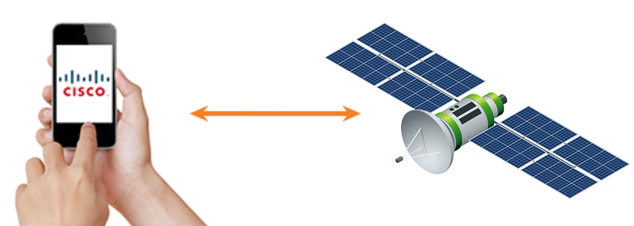
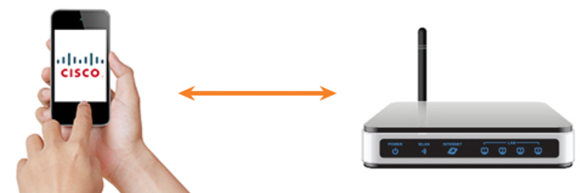
EXPLAIN
Wireless Networks
5 MIN
The GPS uses satellites to transmit signals that cover the globe.
Wi-Fi transmitters and receivers located within the smartphone let the phone connect to local networks and the internet using the signal.
Notes:
GPS the smart phone can receive these signals and calculate the phone’s location to an accuracy of within 10 meters.
Wi-Fi using a wireless network access point to provide signal connection to device.

Slide 39
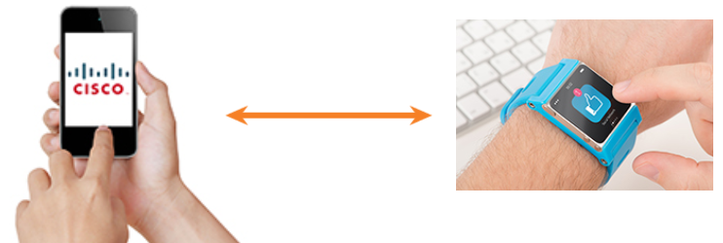
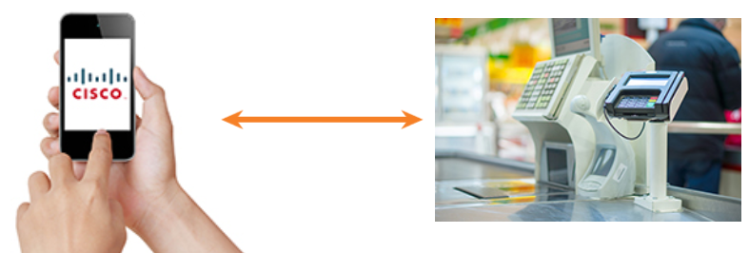
EXPLAIN
Wireless Networks
5 MIN
Bluetooth is wireless technology that allows devices to communicate over short distances.
NFC is a wireless technology that enables data to be exchanged by devices that are in very close proximity to each other.
Notes:
- Bluetooth technology can be used to transmit both data and voice.
- NFC stand for “ Near Field Communication” , the communication usually less than a few centimeters.

Slide 40

Network Trends
2023

Slide 41
EXPLAIN
Recent Network Trends 2023
5 MIN
Several new networking trends that effect organizations and consumers:
Bring Your Own Device (BYOD)
Online collaboration
Video communications
Cloud computing
Smart Home
5G and Beyond
Artificial Intelligence (AI)
Network Automation
Cyber Security
Internet of Thing (IoT)

Slide 42


DISCUSS
Activity Checking Understanding
2
3
5 MIN
Choose the best internet solution for each network size
Click here for the video explanation!
Notes:
Ask student to work in group of two and discuss about the different way to get access to internet.
Let student choose the best internet solution for each network size.

Slide 43


